Slide 1

IEA Hydro Annex XVI Workshop
Hidden Hydro
February 28th, 2022
US Perspectives on
Needed Technology Research and Innovation
Nathalie Voisin, Carly Hansen, Kathryn Jackson

Slide 2
Objective and Outline
Workshop Overarching Question: What research and innovation are needed to tap more hidden hydro opportunities in future?
Annex XVI – Hidden Hydro is organized in three tasks
Task 1: Update hydropower resource potential inventories,
Task 2: Improve the performance of existing hydropower facilities,
Task 3: Add power to non-powered dams and water management/conveyance facilities
For each task, we characterize the advances and challenges addressed by recent and ongoing USDOE projects and identify remaining challenges and research needs.
Performance of assets
Adding Power to assets
Inventories of assets
Notes:
A brief overview of recent and ongoing EERE Water Power technology Office Efforts on Inventories for existing and potential hydropower assets, approaches to enhance performance of existing assets and adding power to asset and the systems. Specifically, the brief review synthetizes the addressed challenges and supports the identification of research gaps.

Slide 3
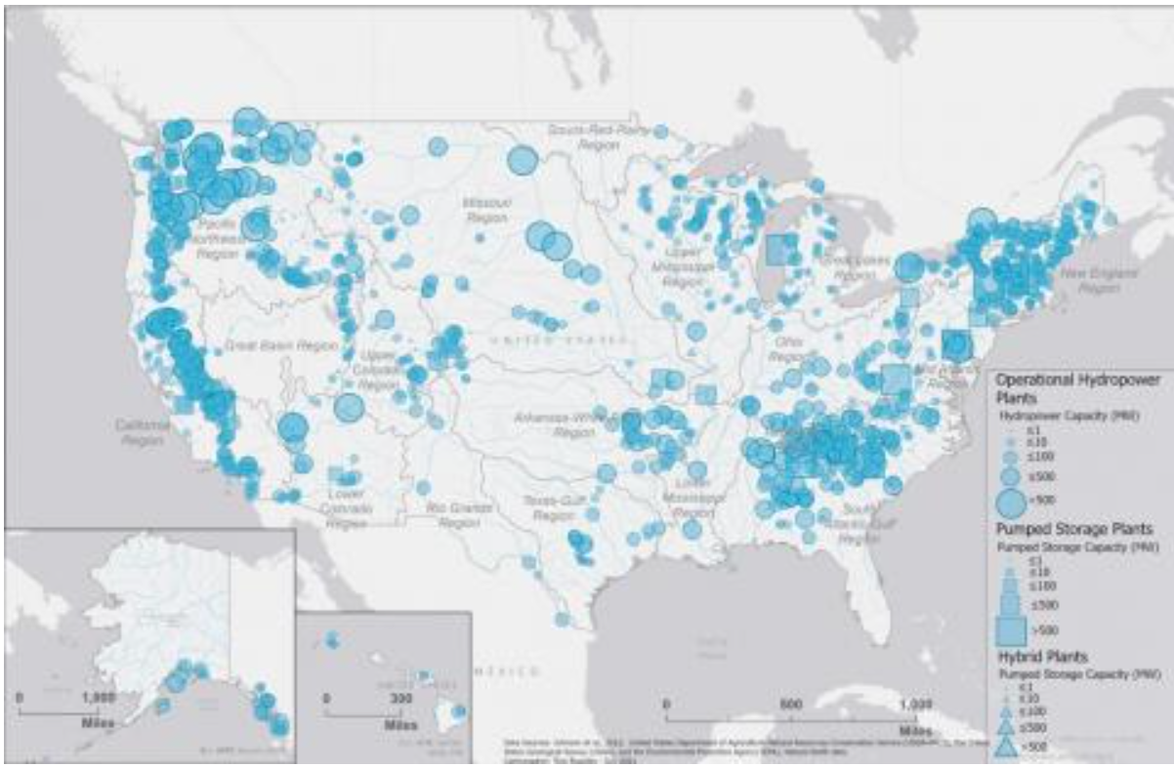
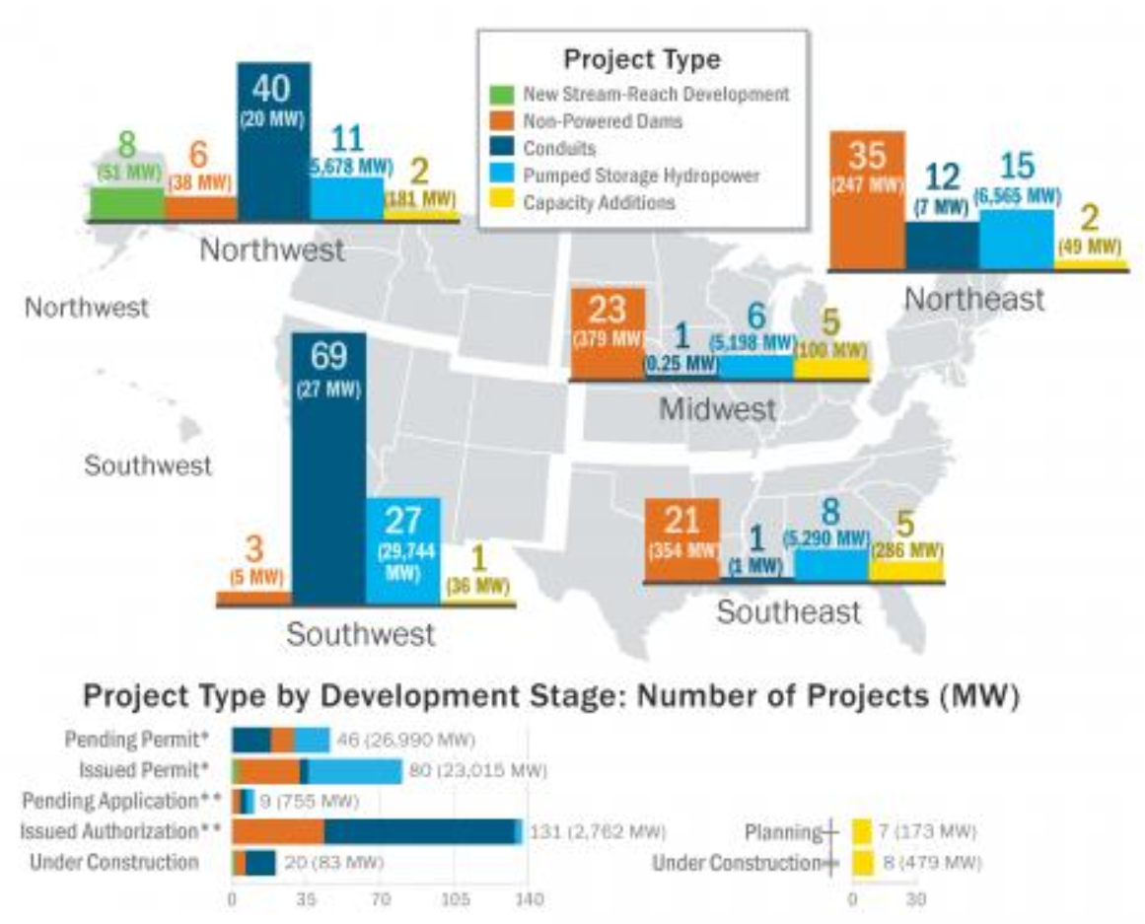
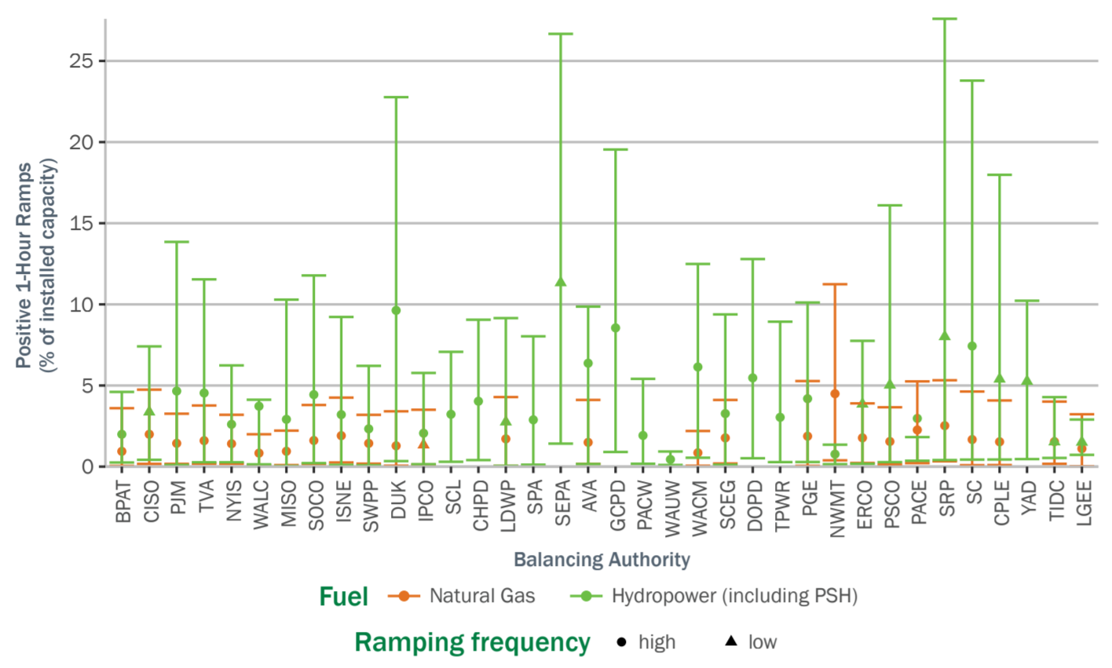

Hydropower Resources Potential Inventories - Existing
Recent & Ongoing
R&I Needs
M.M. Johnson, S.-C. Kao, N.M. Samu, and R. Uria-Martinez, Existing Hydropower Assets, 2021. HydroSource. Oak Ridge National Laboratory, Oak Ridge, TN. DOI: 10.21951/EHA_FY2021/1782791
Hydropower Value Study: Current Status and Future Opportunities. United States: N. p., 2021. Web. https://www.osti.gov/servlets/purl/1764624
Uría-Martínez, R., M. M. Johnson, and R. Shan (2021). U.S. Hydropower Market Report Data. January 2021. Washington, DC: Water Power Technologies Office, U.S. Department of Energy [Excel data]. DOE/EE- 2088.
Challenges Addressed: Data Availability, Business Sensitivity and Interoperability
Existing Hydropower Assets (EHA)
Hydropower Market Reports
Hydropower Value Study
Compromises on spatial and temporal scales,
Spatial extent and temporal coverage
Coincidence of datasets
Existing Hydropower Assets (EHA 2021)
Hydropower Market Report (2021)
BA ordered in decreasing installed hydropower capacity
2019 one-hour ramps per installed MW for hydropower (include PSH) and natural gas by balancing authority.

Slide 4

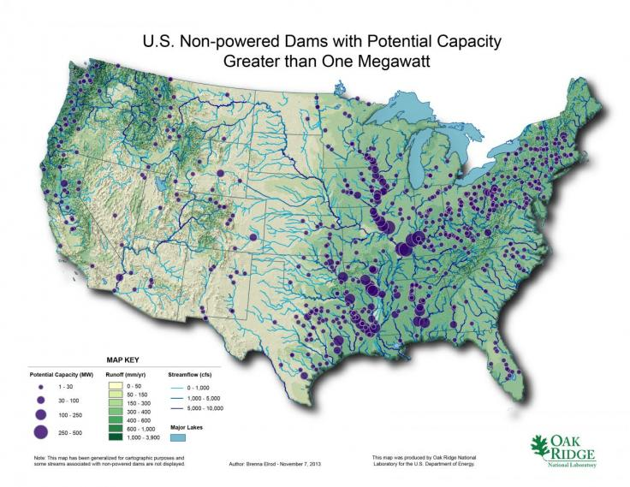
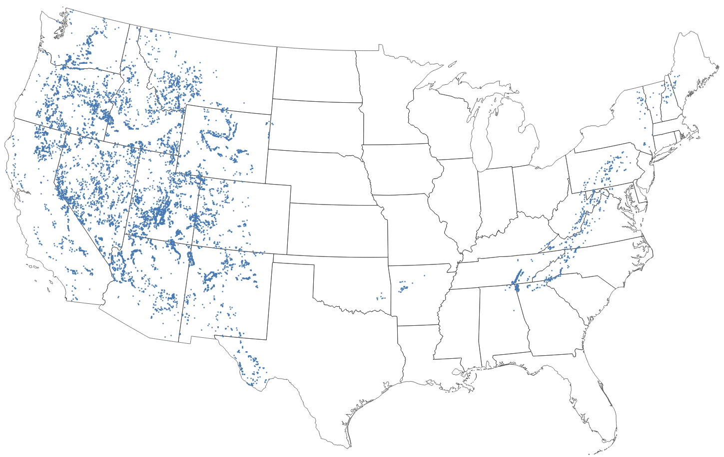
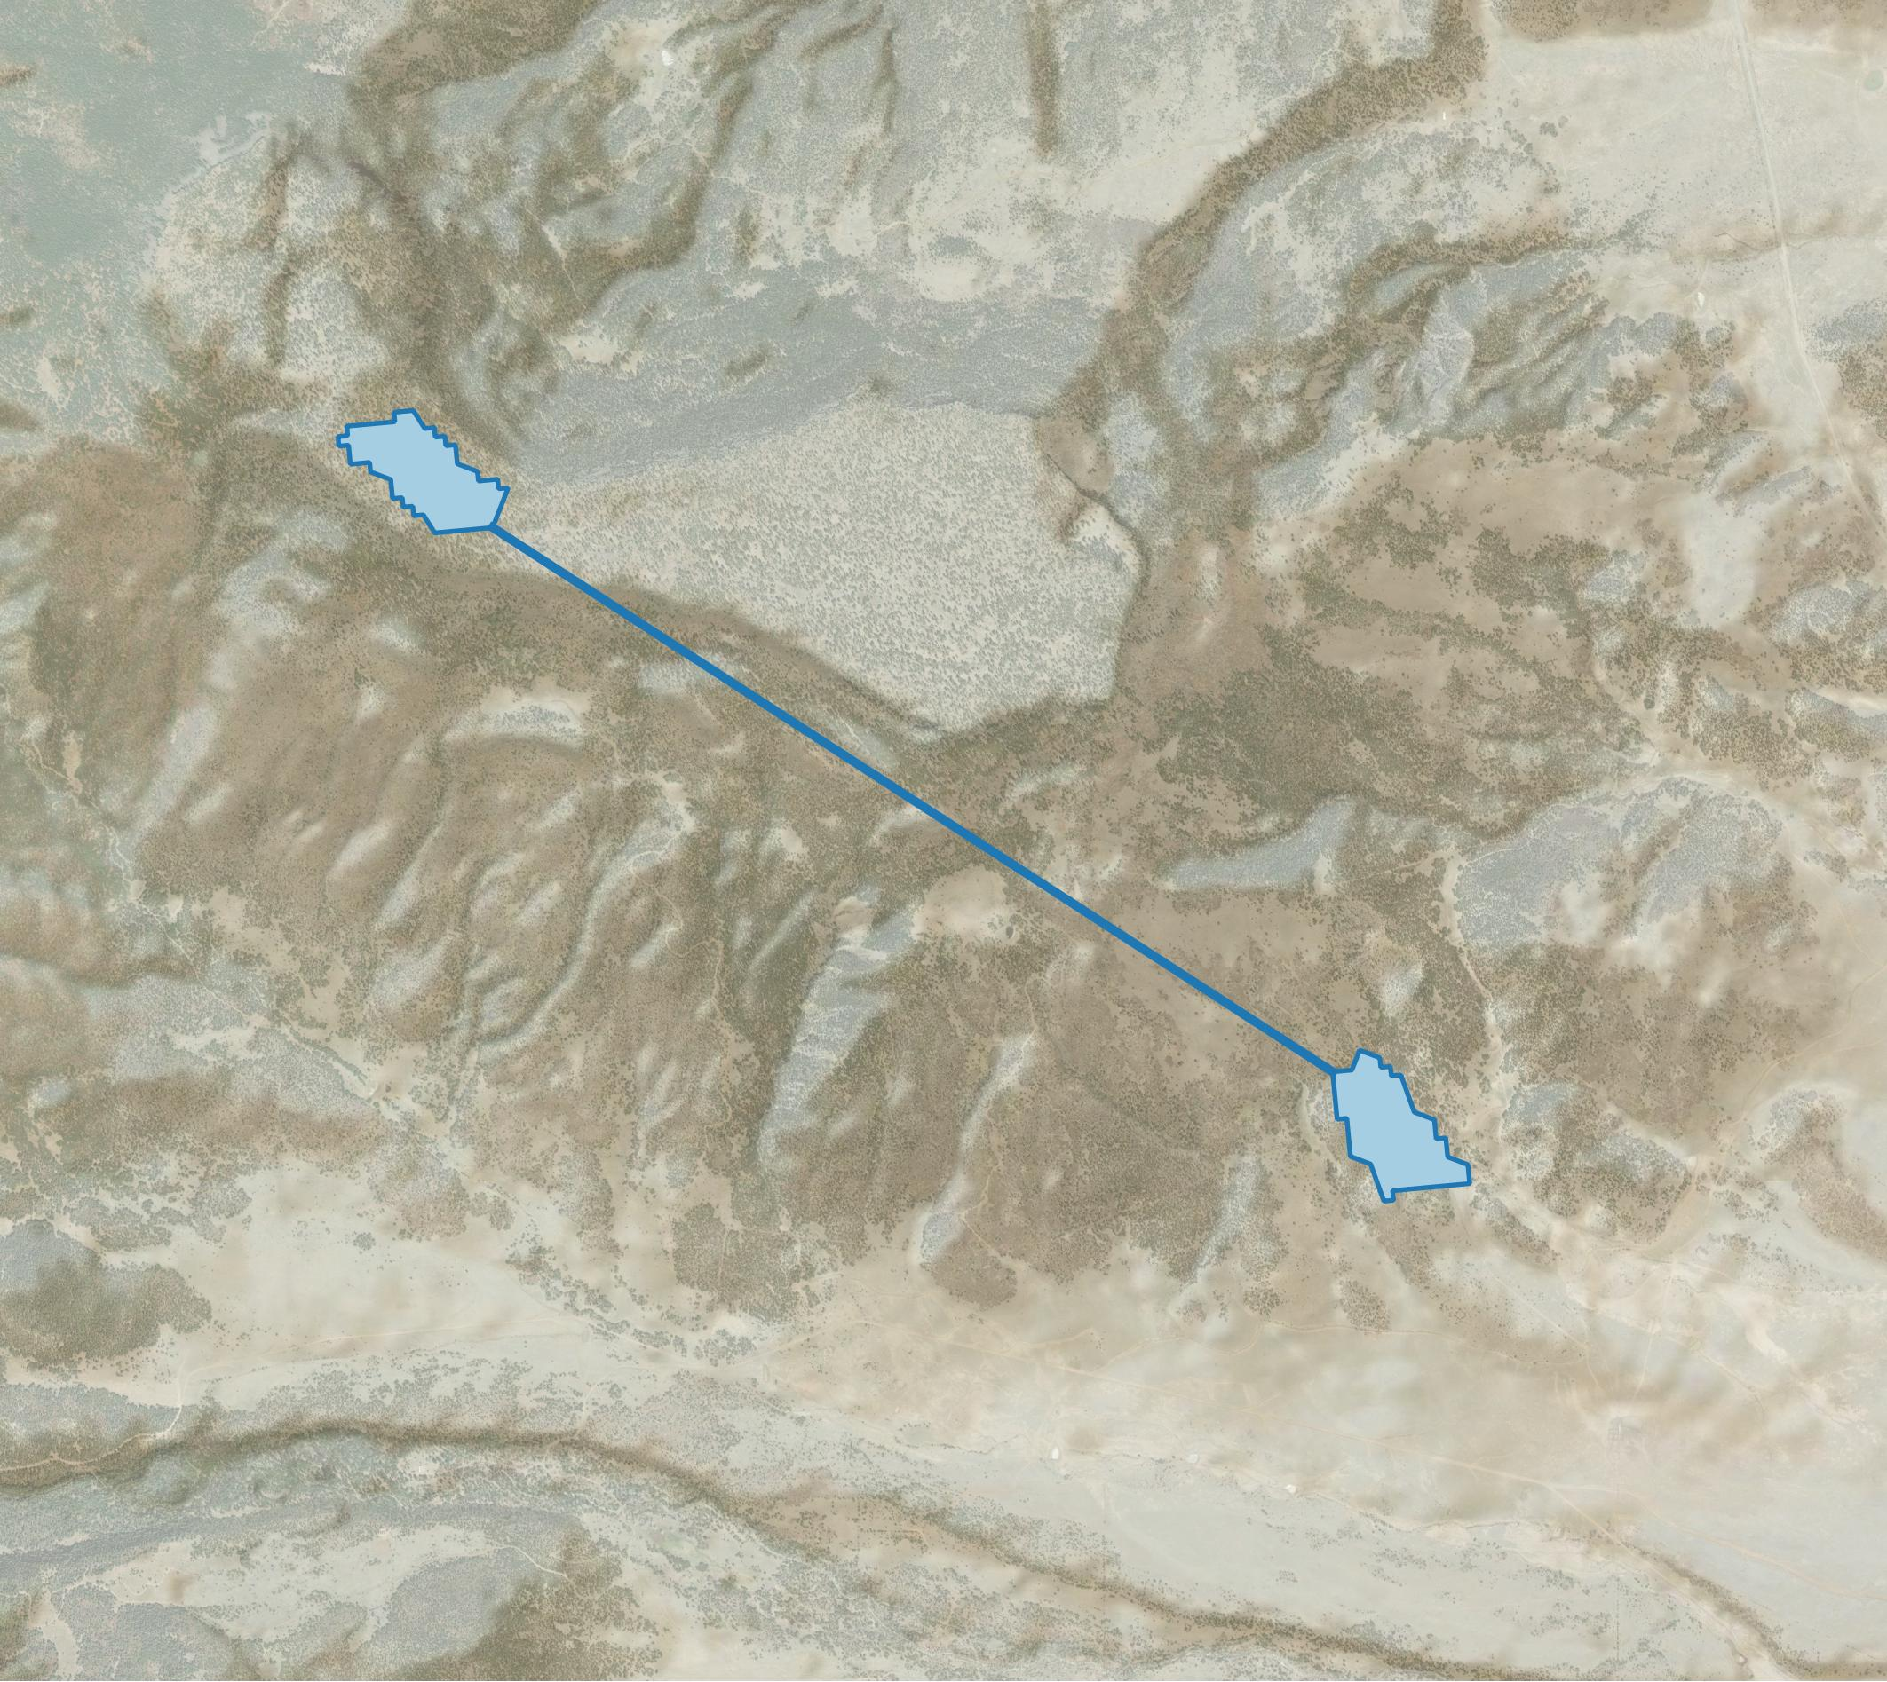
Hydropower Resources Potential Inventories - Potential
Recent & Ongoing
R&I Needs
Johnson, M.M., and Uría-Martínez, R., (2021). U.S. Hydropower Development Pipeline Data, FY2018. DOI: 10.21951/HMR_PipelineFY18/1810097
Rosenlieb, Heimiller, & Cohen (2022) Closed Loop Pumped Storage Hydropower Resource Assessment for the United States (forthcoming).
Challenges Addressed: Data Availability, Geospatial Analysis, Engineering Feasibility at scale
Conduit Assessments
Pumped Storage Hydropower Assessment
From Feasibility to Adoption
High-resolution long-term water availability
US Water Laws (rights, markets)
High resolution interconnection cost
Business cases (incentives, return on investment)
Closed-Loop Pumped Storage Hydropower Resource Assessment for the US
Example of reservoir pairs

Slide 5
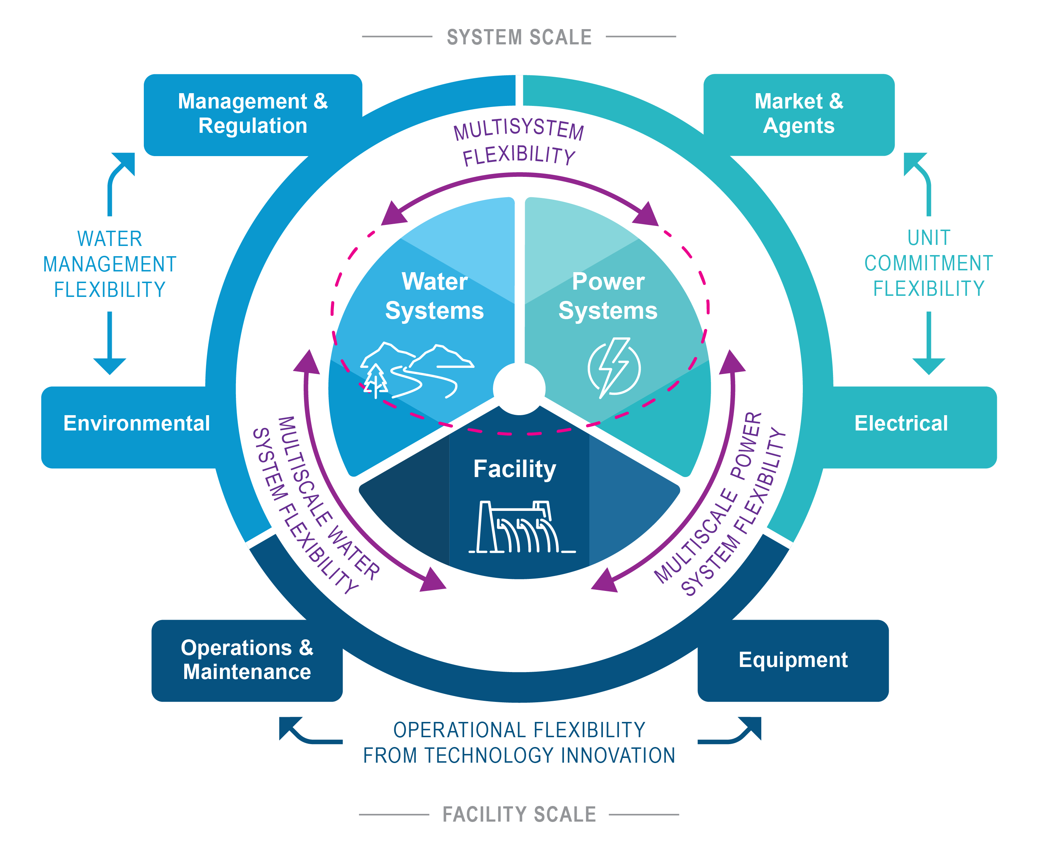

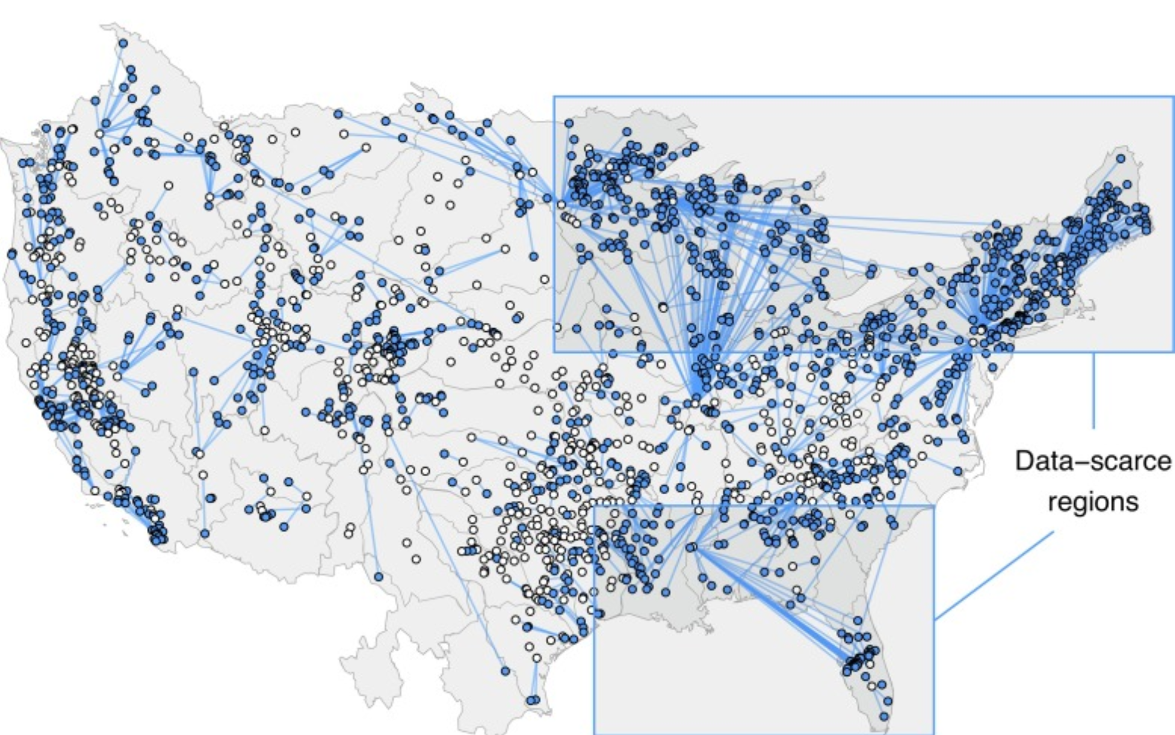
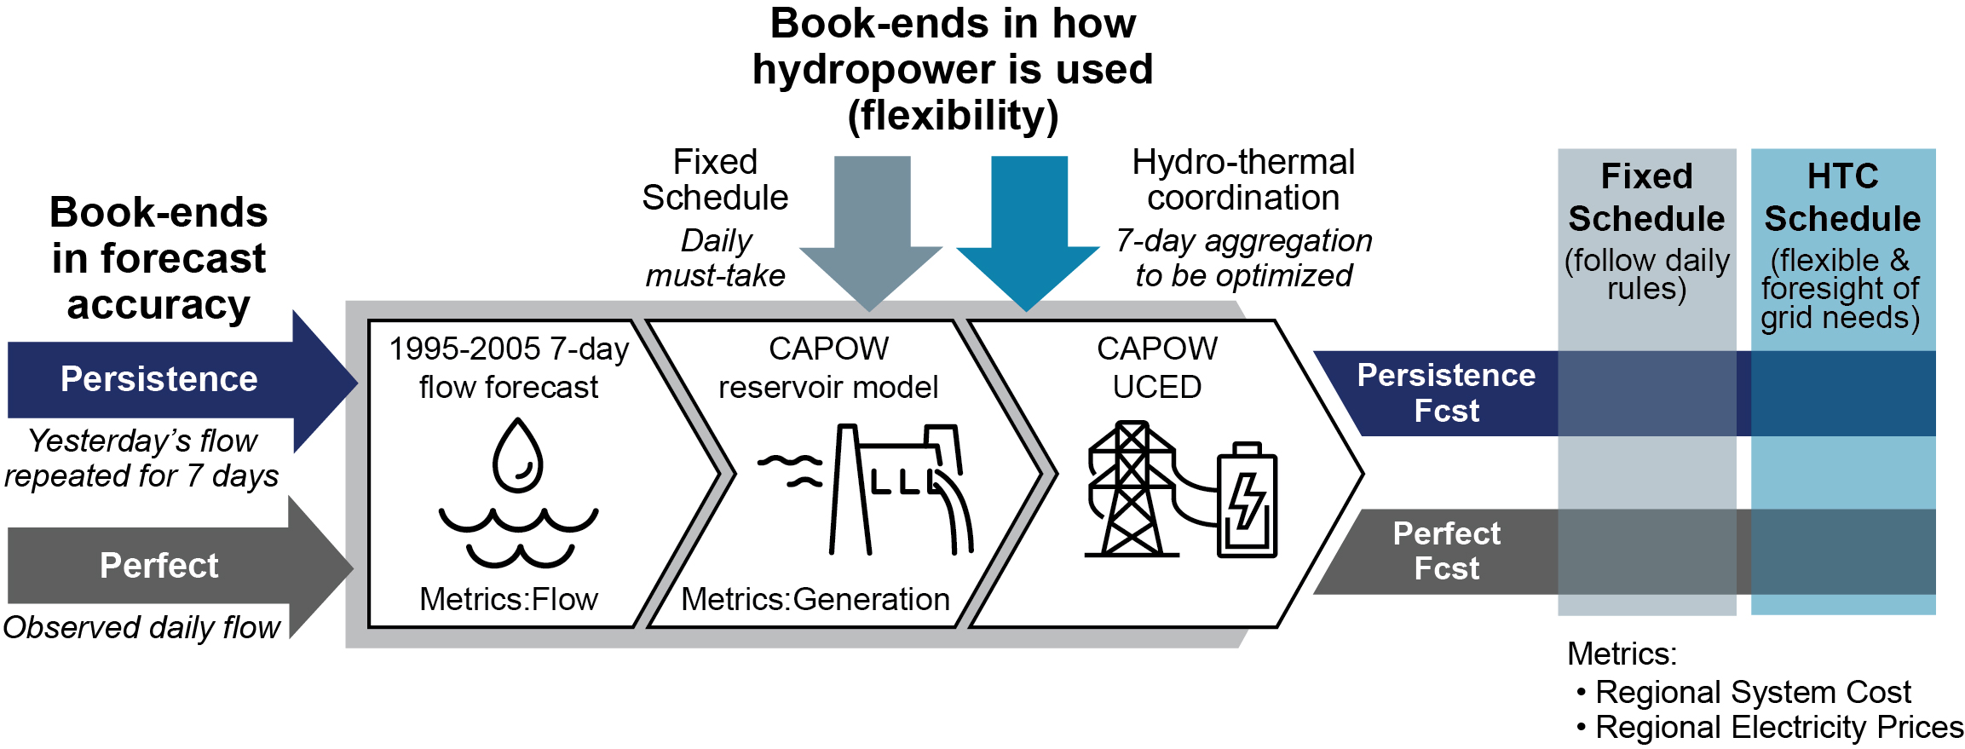
Improving the Performance of Hydropower Facilities – Grid Scale
Voisin et al. 2022: Value of Flow Forecast to Power System Analytics
Voisin et al. 2022: A new Hydropower representation for resources adequacy in the Western US
Turner, S.W.D., Steyaert, J.C., Condon, L. and Voisin, N. 2021. Water storage and release policies for all large reservoirs of conterminous United States. Journal of Hydrology 603, 126843.
Ploussard Q.M.,T. Veselka, and K. Oikonomou, N. Voisin. 2022 "Hydro-Economics Tradeoff Surfaces to Guide Unit Commitment in Production Cost Models." PNNL-SA-161866.
Recent & Ongoing
R&I Needs
Challenges Addressed: scale, coupling of large-scale water and power systems, large-scale hydropower scheduling models
Value of flow forecast to power system analytics
Weekly Hydropower Dataset to support resources adequacy in the Western US
Regional scale hydrological modeling and reservoir operations
Optimization: regional diversity, centralized (co-)optimization and facility-scale optimization
Diversity in Concepts of Hydropower Flexibility
Water storage and release policies for over 600 reservoirs
Value of Flow Forecast For Power System Analytics – 300 power plants
Notes:
Controls and equipment not presented here
Better define performance – utility or grid perspective? Stakeholder or grid resilience?

Slide 6
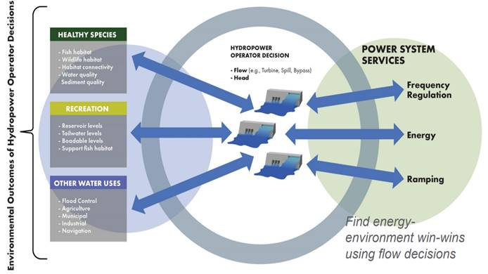
Improving the Performance of Hydropower Facilities – Regional Scale
Recent & Ongoing
R&I Needs
Challenges Addressed: tradeoffs in power-water systems, environmental regulation, multi-stage optimization
Framework for Linked Analysis of Streamflow and Hydropower (FLASH)
Environmental Decisions and Power System Tradeoffs
Computational methods
Data availability
Barrows, Stark et l. 2022: FLASH Framework for Linked Analysis of Streamflow and Hydropower
Pracheil et al. 2022: Improving Hydropower Benefits by Linking Environmental Decisions and Power System Tradeoffs Through Flow Release Decisions
Tradeoffs across diversity in river and power system services
New modeling platform to accommodate multi-stage hydropower scheduling optimization
Notes:
Controls and equipment not presented here
Better define performance – utility or grid perspective? Stakeholder or grid resilience?

Slide 7

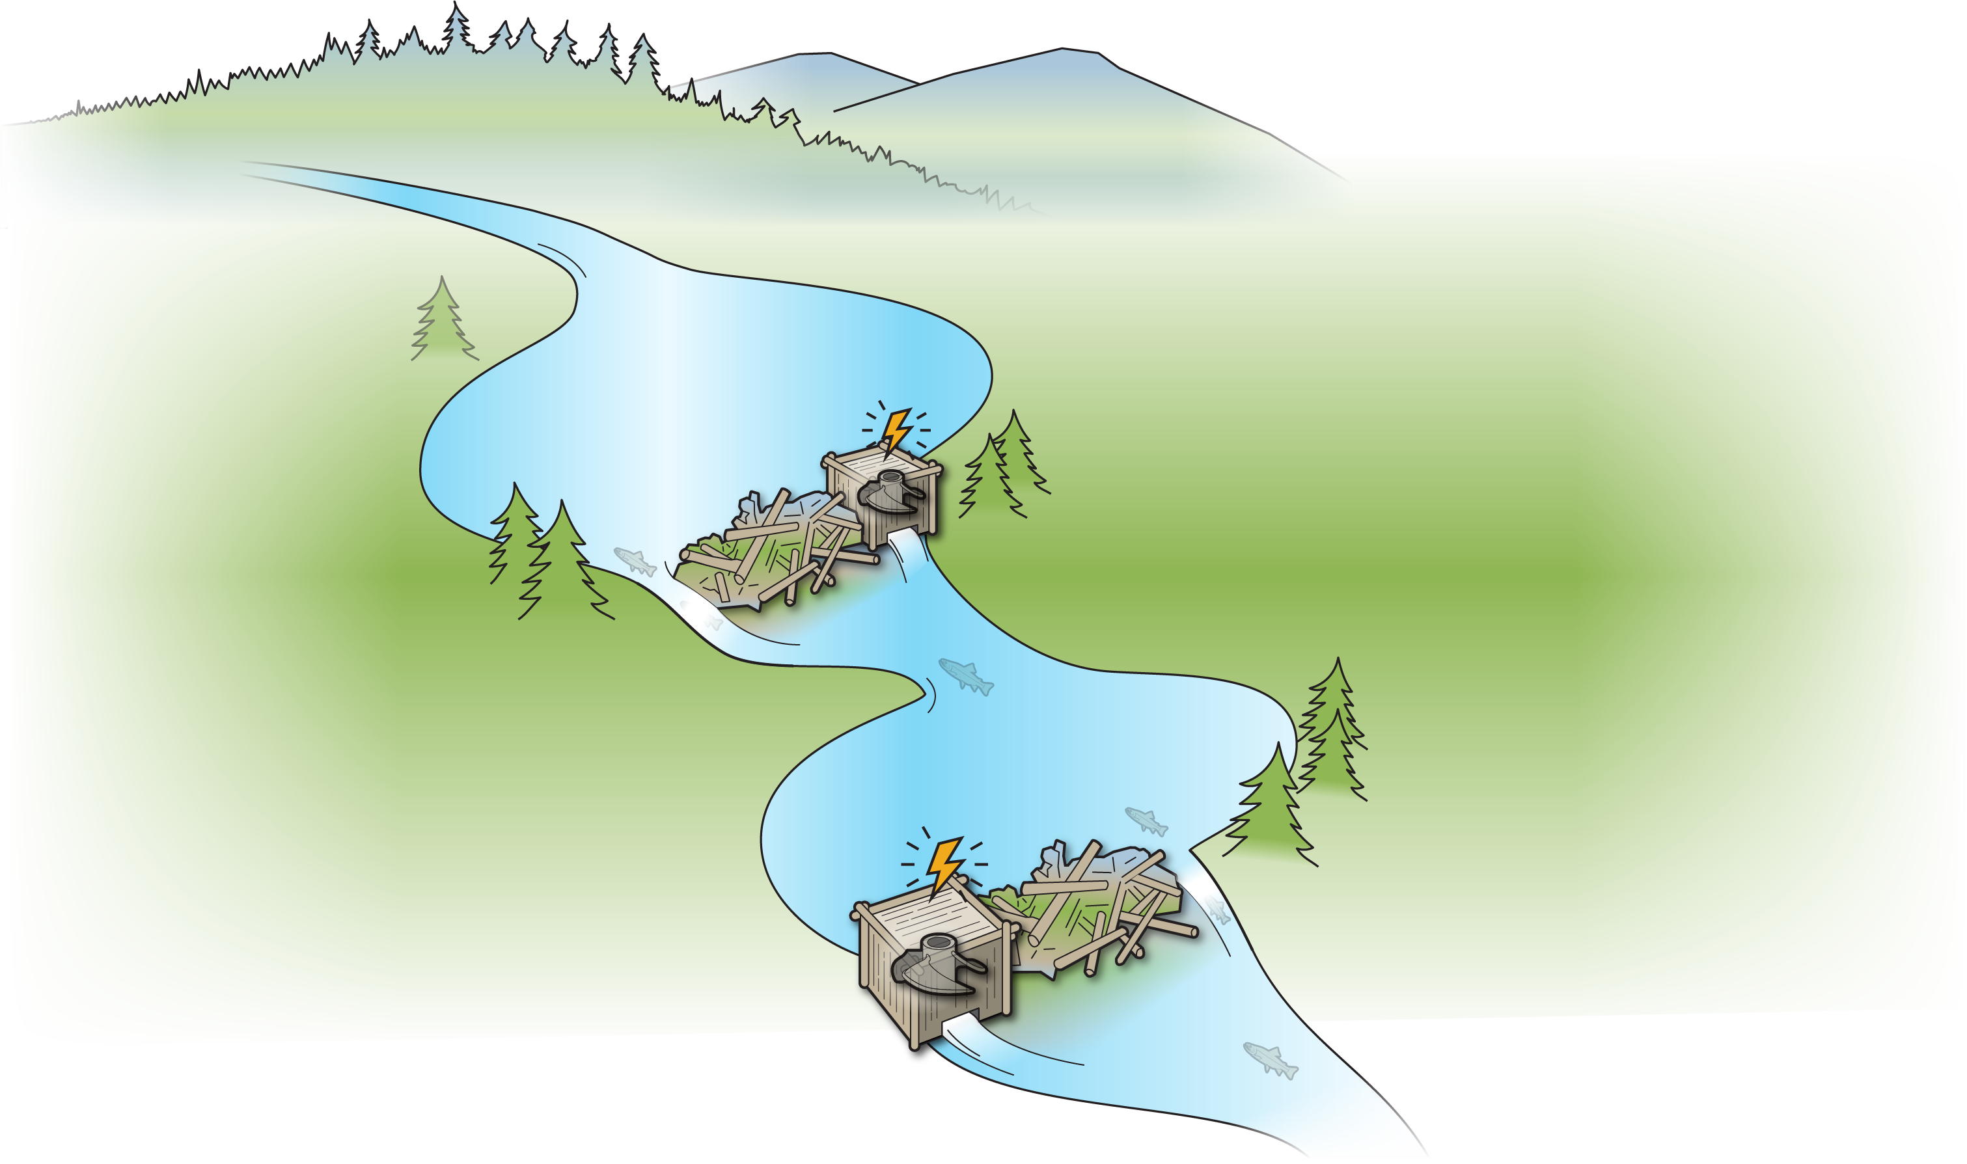
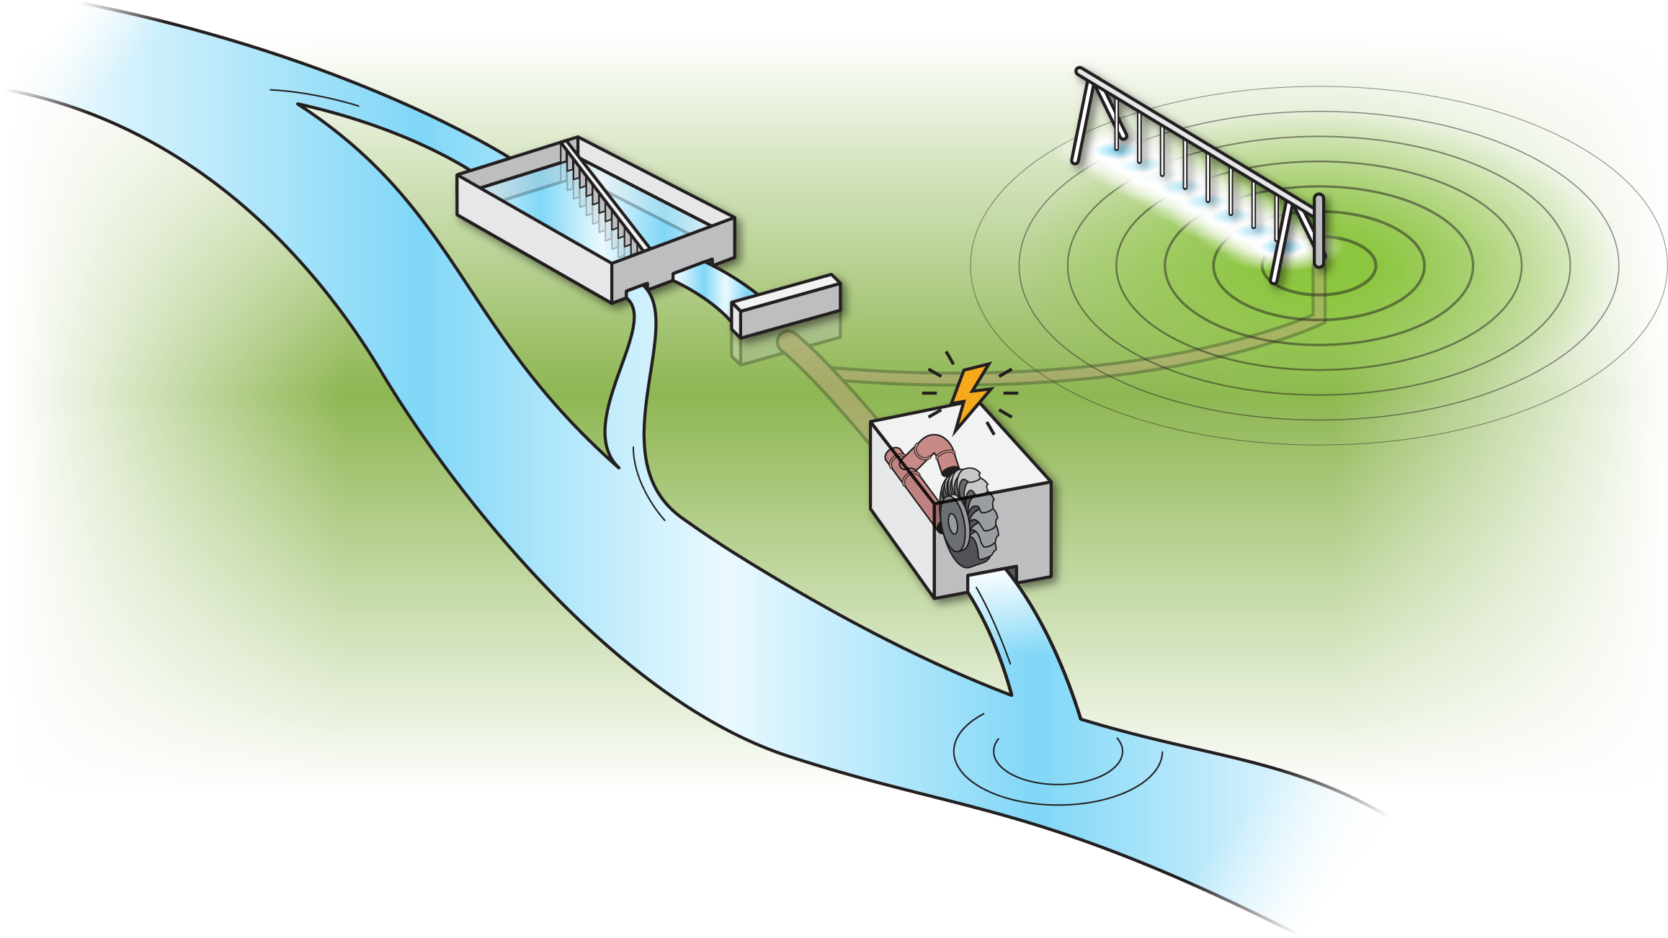
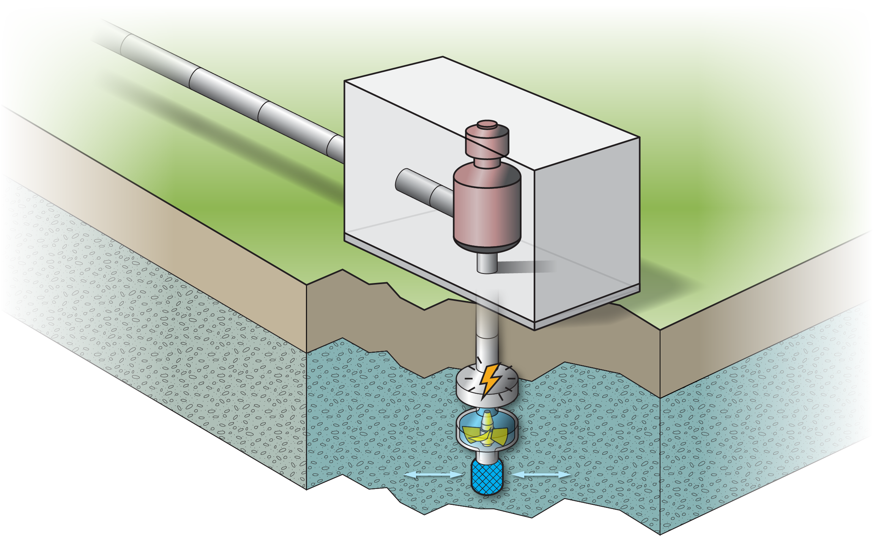
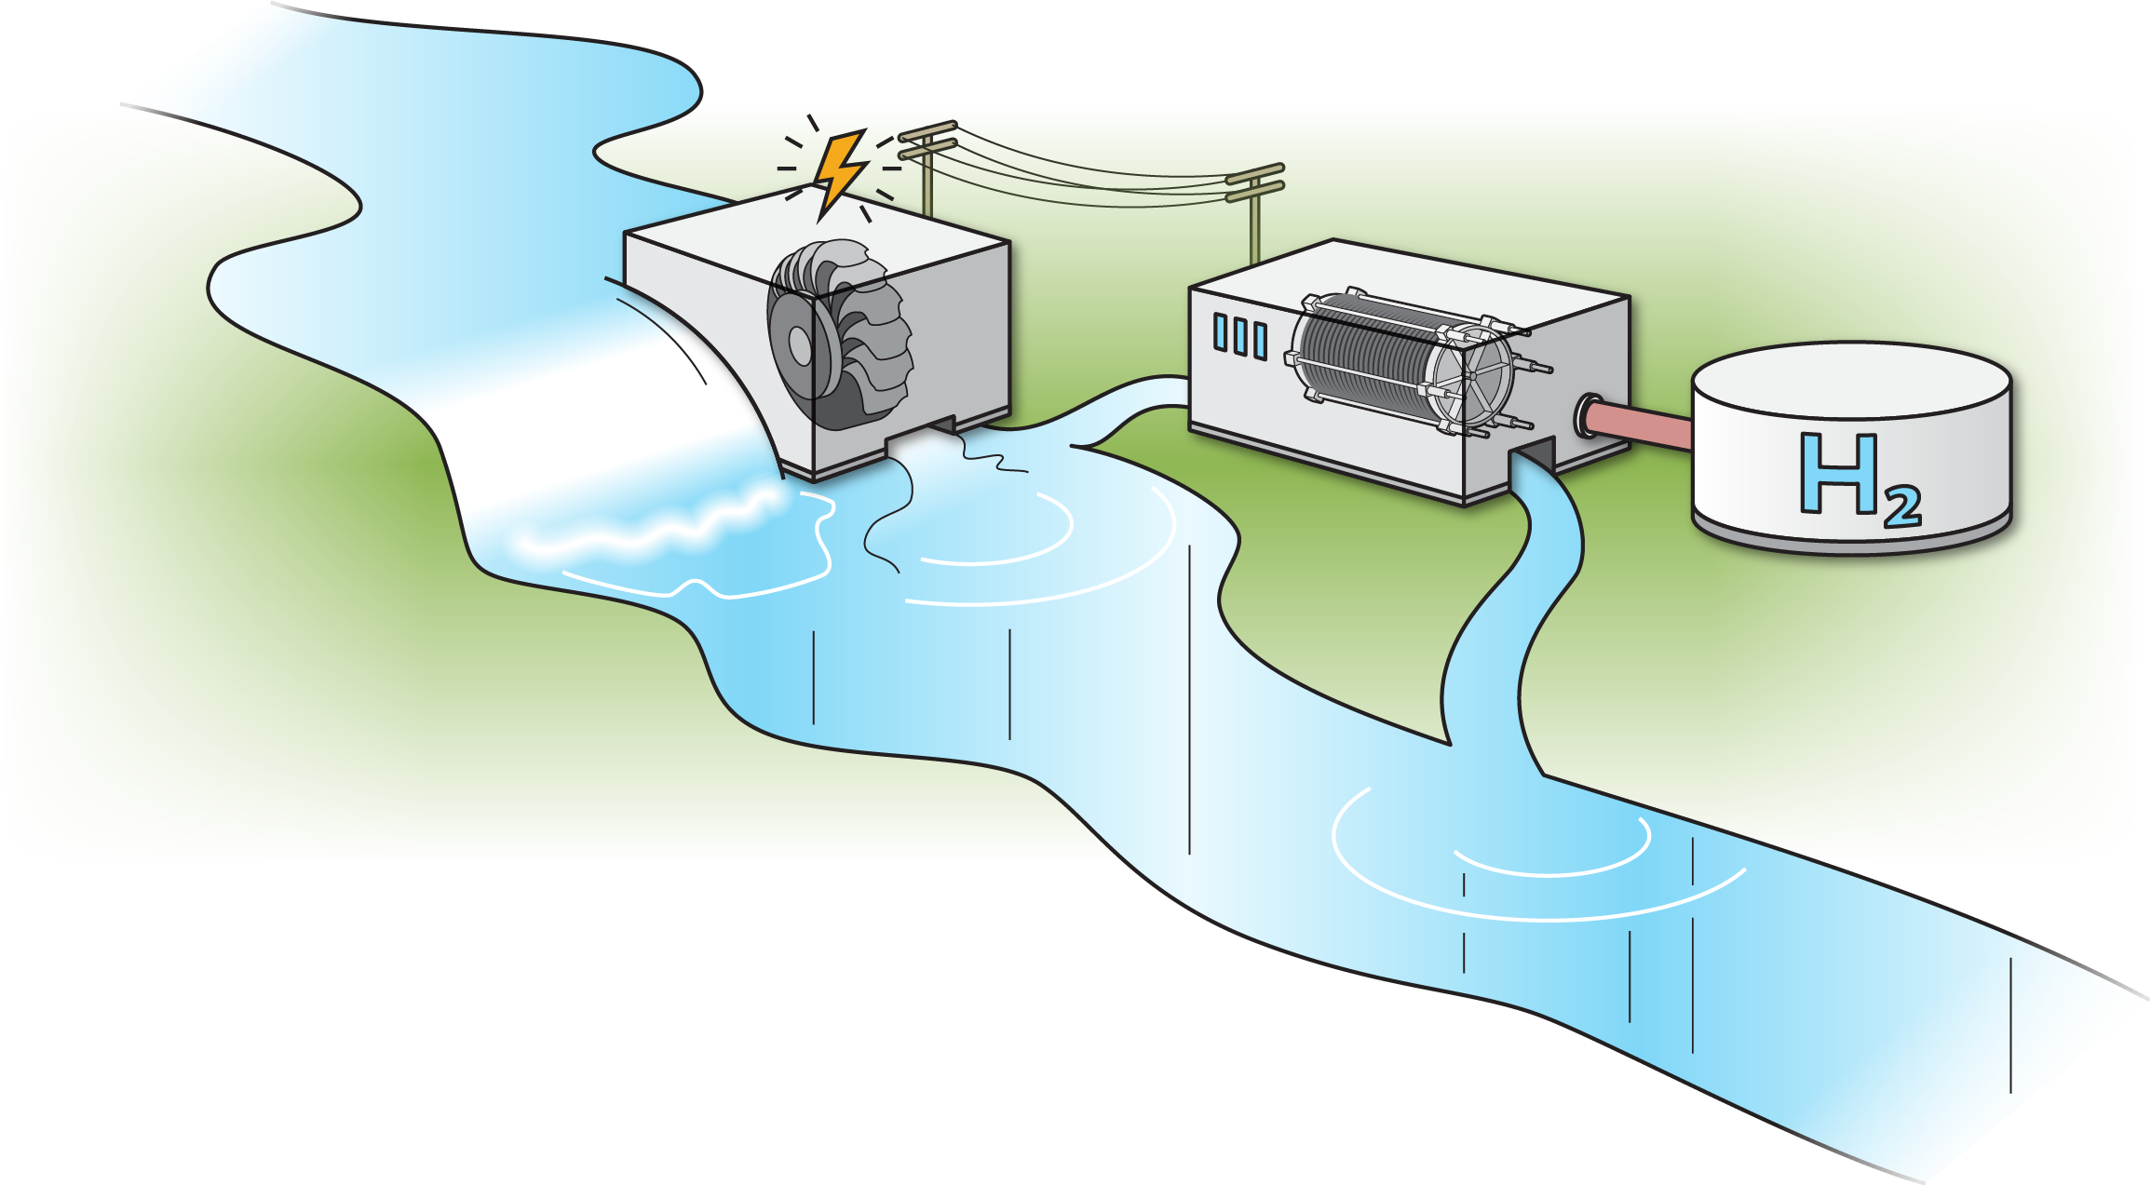
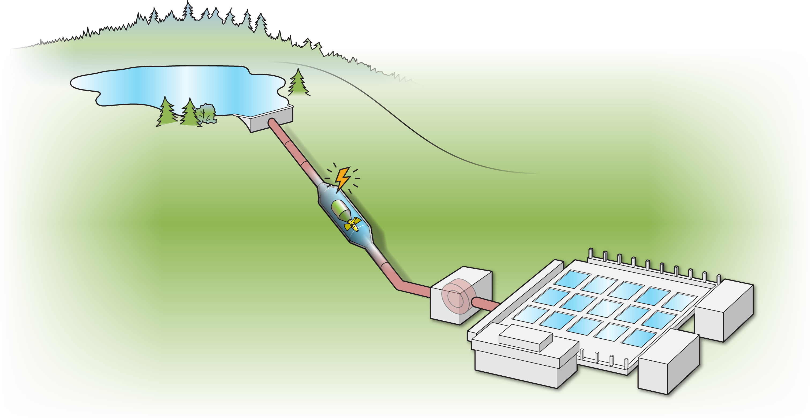
Adding Power to Non-Powered Dams and Water Management Facilities
Recent & Ongoing
R&I Needs
Oladosu, G.A., Werble, J.M., Tingen, W.J., Witt, A.M., Mobley, M.H. and O'connor, P., 2019. An Assessment of Hydropower Environmental Mitigation Costs (No. ORNL/TM-2019/1245). Oak Ridge National Lab.(ORNL), Oak Ridge, TN (United States).
Prasad, Mosier, Saulsbury et al. 2022: Alternative Oppotunities
Challenges Addressed: stakeholder engagement specifically access to consolidated data, range of engineering options, harmonization of value drivers
Non-Powered Dam Explorer (NPD Explorer) & Categorization (NPDamCAT)
Cost Analysis at Non-Powered Dams
Alternative Opportunities
Uncommon Dialogue
Stakeholder engagement science – generalization
Multi-sectoral datasets
Data Availability
Environmental Restoration and Cleanup
Irrigation Modernization
Source Water Recharge
Deferrable Loads
Water Supply and Treatment
Notes:
, a geovisual analytics platform that empowers user-guided energy-water-environment-module data analysis and inquiries in support of SMH development
INL-PNNL Alternative Opportunities: stakeholder engagement complemented with feasibility and cost analysis research and tools

Slide 8
Overall Thoughts on Research and Innovation Needed to Tap More Hidden Hydro
Technology
Initial focus on gross potential, then technically feasible, and now economically sustainable.
Need to consider hidden hydro in the context of overall water and power systems, and changes in market values to promote adoption by the community and investors.
Diversity in hidden hydro opportunities – silo between disciplines
Modeling workflows and data availability
Performance
Adding Power
Inventories
Research Programs and Funding Venues
HydroWIRES initiative
Industry engagement (utilities, system operators, regulators)
Project formats to evaluate both diversity and generalizable performance (test beds, case studies, large scale)

Slide 9
Thank you
Nathalie.Voisin@pnnl.gov Hansench@ornl.gov@ornl.gov Kathryn.Jackson@ee.doe.gov

