Slide 1
IEA Annex XVI Task 3 Overview: Adding Power to Non-Powered Infrastructure
February 28, 2022 Workshop: What Research and Innovation are Needed to Tap More Hidden Hydro Opportunities in the Future?
Carly Hansen
Water Resources Engineer at Oak Ridge National Laboratory, USA
IEA Annex XVI Task 3 Lead

Slide 2
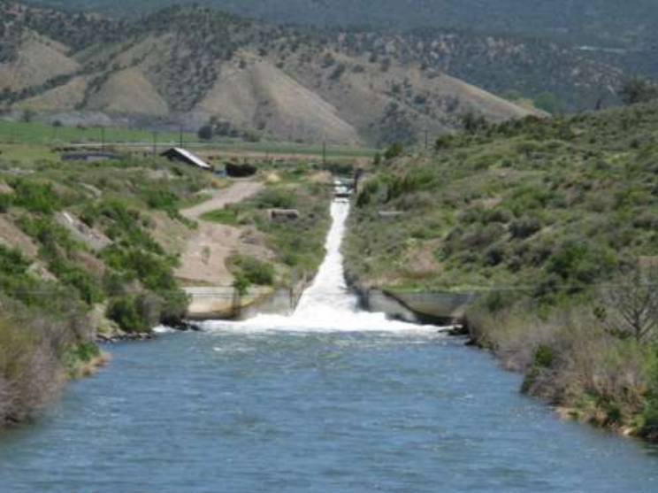
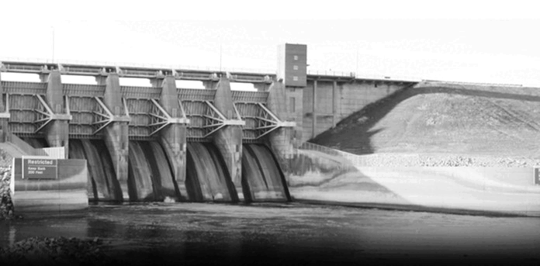
Hidden hydro opportunities using existing non-powered infrastructure
Broad spectrum of infrastructure:
Dams
Low-head barriers
Locks
Canals
Conduits/water systems
Mining/debris storage
US Bureau of Reclamation South Canal Hydropower Project
US Army Corps of Engineers Red Rock Dam Project
Portland Conduit 3 LucidPipe Project

Slide 3
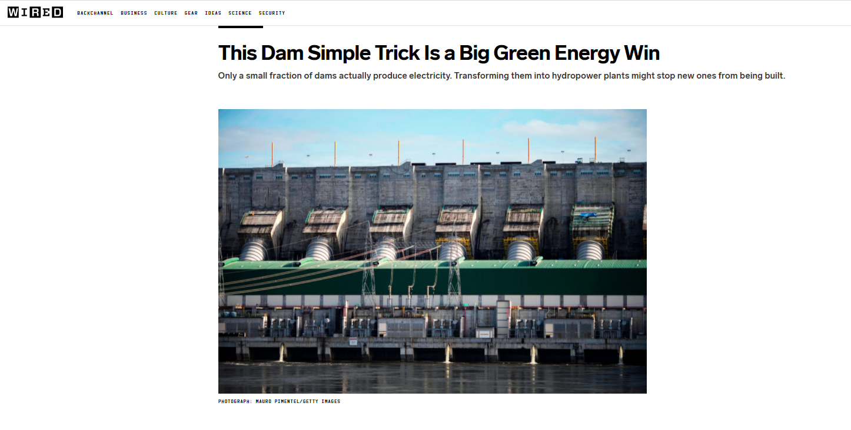
Hidden hydro opportunities using existing non-powered infrastructure
Motivation:
Maximizing use of existing structures/facilities
Reduced capital costs
Reduced carbon footprint compared to new development
Co-improvement and development opportunities
Structures are already supporting other purposes
Other non-hydropower benefits may be possible
Excerpt from November 2021 article in WIRED magazine

Slide 4
Hidden hydro opportunities using existing non-powered infrastructure
Objectives:
Identify and evaluate the opportunities using existing non-powered infrastructure
Create a catalog of projects
Represent the spectrum of types of projects
Determine patterns (regionally, over time, etc.)
Overlap with Annex XVI Task 1 (Inventories)
Help describe current state of inventories of non-powered dams, canals, water systems
Identify characteristics of these projects that should be included in inventories
Overlap with Annex XVI Task 4 (Research & Innovation)
Highlight particularly innovative or noteworthy projects – where did recent R&I make a difference?
Determine driving factors for successful projects – what R&I could improve or optimize these factors?
Outline obstacles to these types of projects – what R&I is needed to address them?

